Slide 1
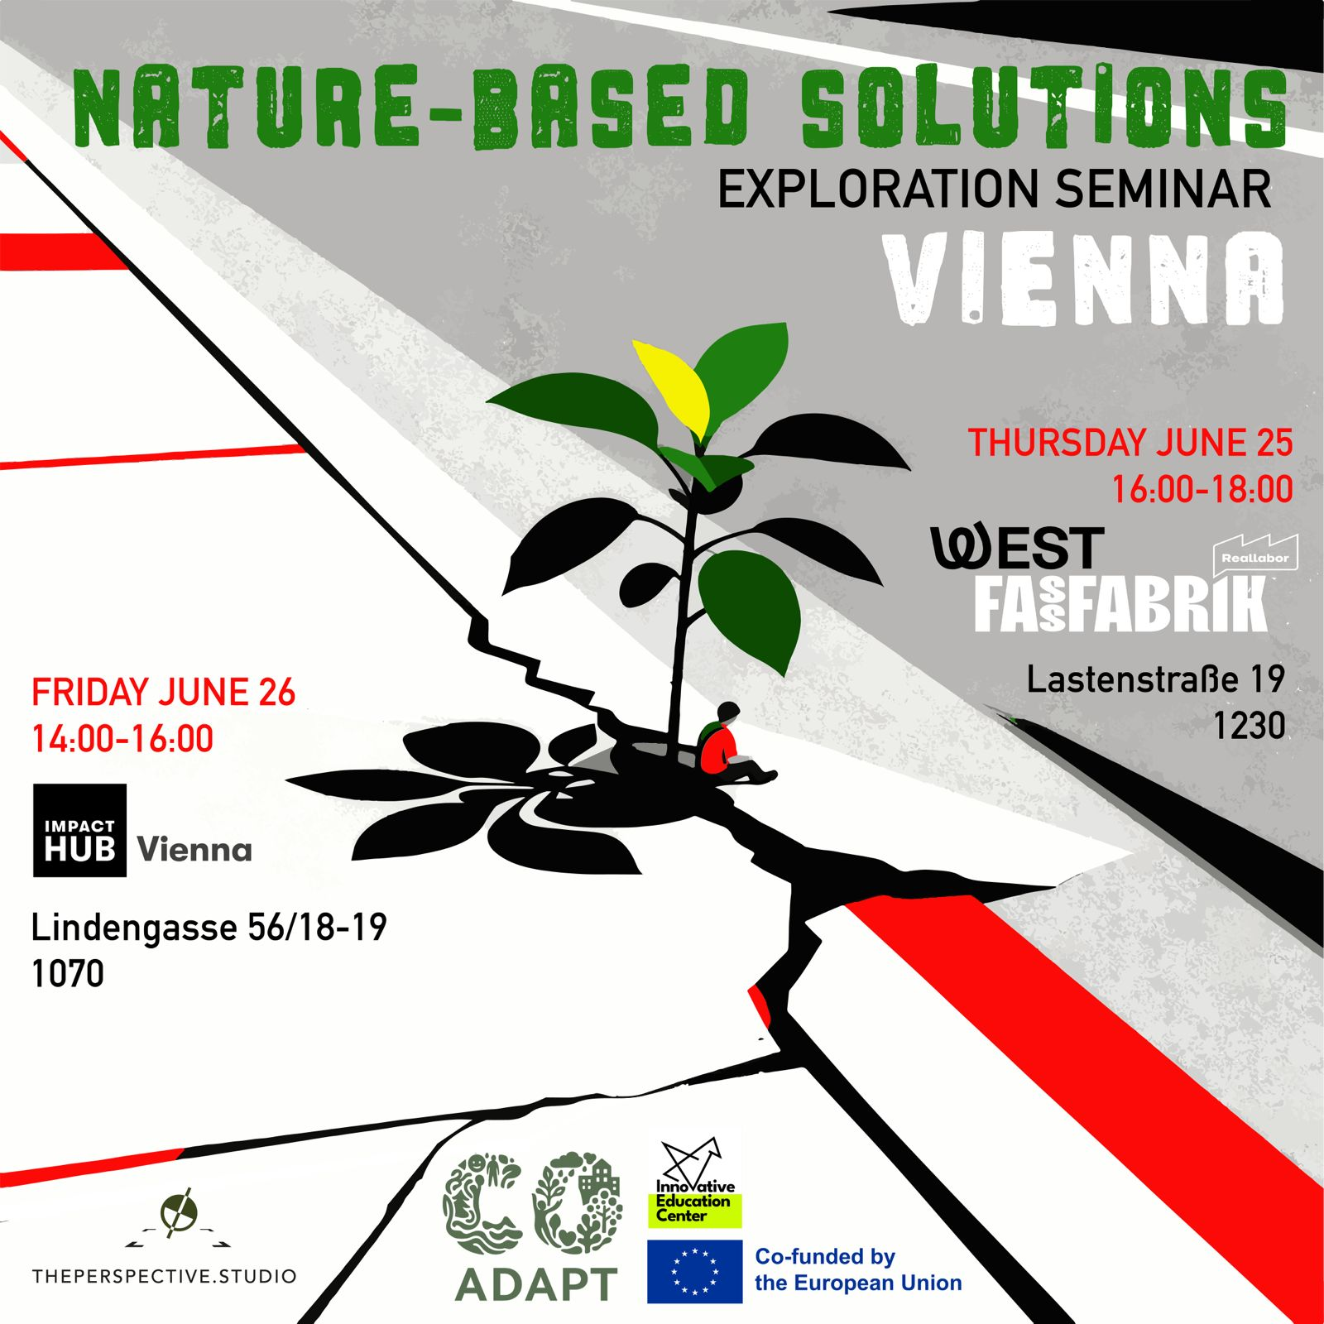
Co-ADAPT
Community-led Nature-based Solutions for Climate Adaptation
Inspiration from Europe, Austria and Vienna
Vienna | Nature-Based Solutions Exploration Seminar
Notes:
Good afternoon everyone, and thank you for being here today.
Before we begin, I'd like to ask a simple question:
When was the last time nature surprised you in a city?
Perhaps it was a tree growing through a crack in the pavement, a bird nesting on a building, or a shaded street that felt noticeably cooler on a hot summer day.
Today, we will explore those moments where nature and urban life intersect. We will look at inspiring examples from across Europe and discuss how ordinary citizens can become active participants in creating greener, healthier, and more resilient cities.
This seminar is part of the Co-ADAPT project, which aims to bring nature-based solutions closer to communities and everyday life.

Slide 2

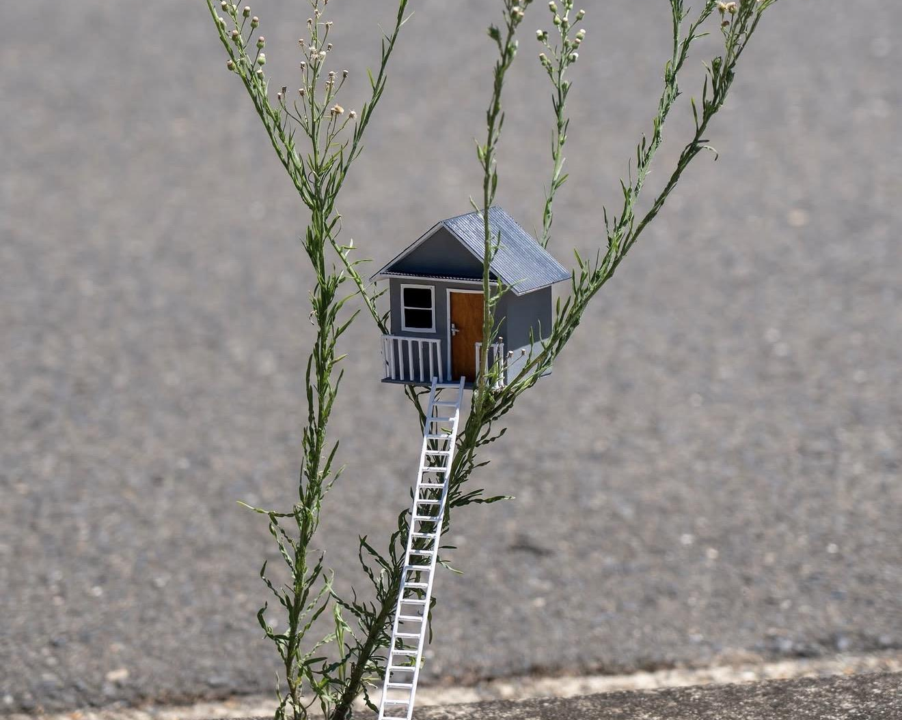
CO-ADAPT | Nature-Based Solutions Seminar
Moment of Reflection
When was the last time nature surprised you?
Artwork and image by Michael Pederson / @miguelmarquezoutside

Slide 3
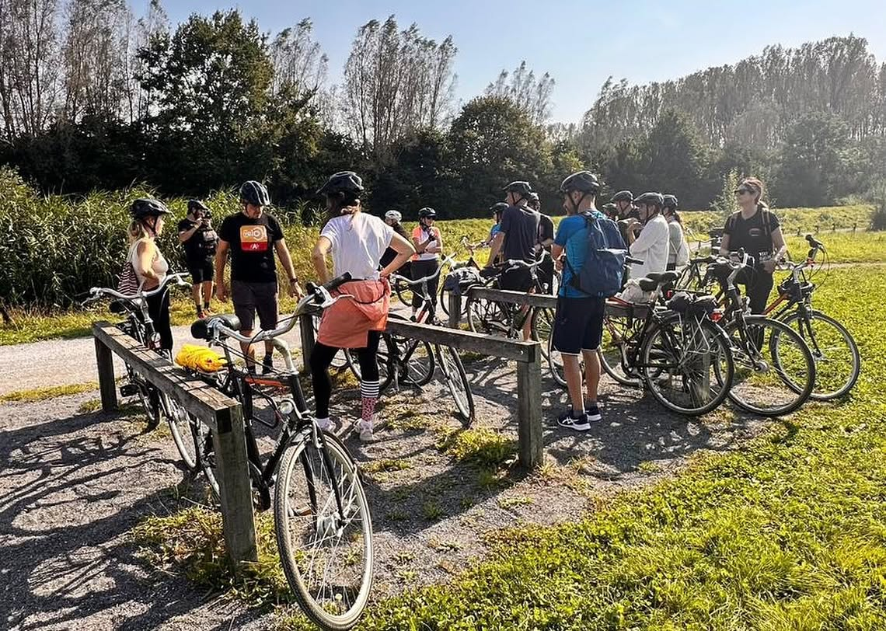
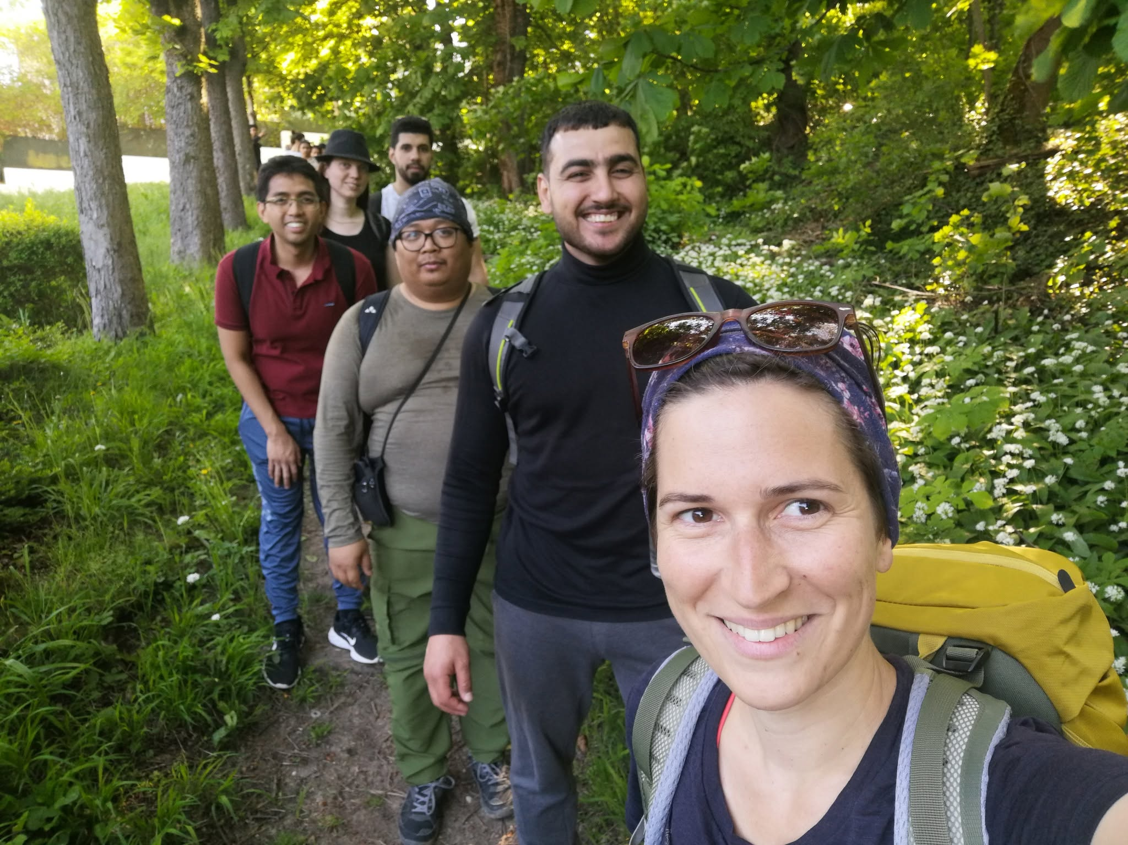
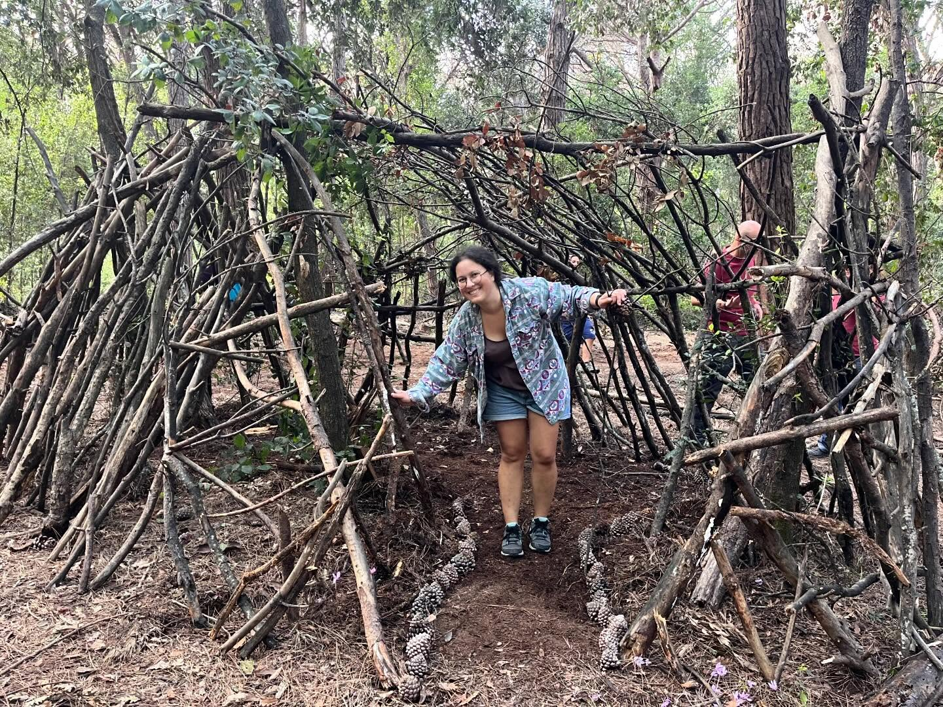
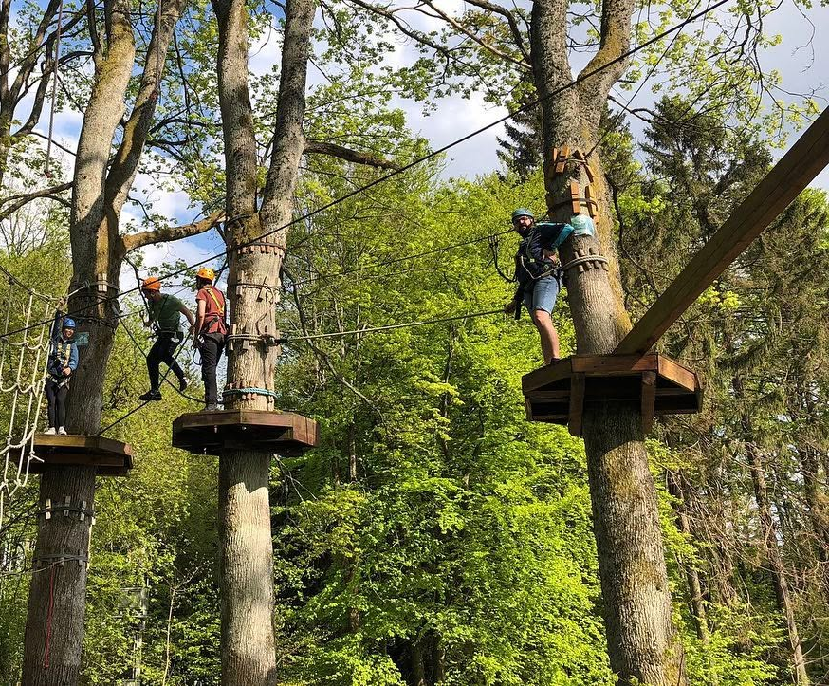
CO-ADAPT | Nature-Based Solutions Seminar
About IEC
Innovative Education Center
Vienna-based non-profit NGO
Creates sustainable impact through education and community action
Promotes resilience, equality and healthy lifestyles
Works with green entrepreneurship, active citizenship and climate resilience
www.zentrumib.org
Notes:
Before we continue, let me briefly introduce our organization.
The Innovative Education Center, or IEC, is a Vienna-based non-profit organization working in the fields of sustainability, education, active citizenship, and climate resilience.
We believe that meaningful change happens when people are empowered to learn, participate, and take action together.
That philosophy is also at the heart of Co-ADAPT.

Slide 4

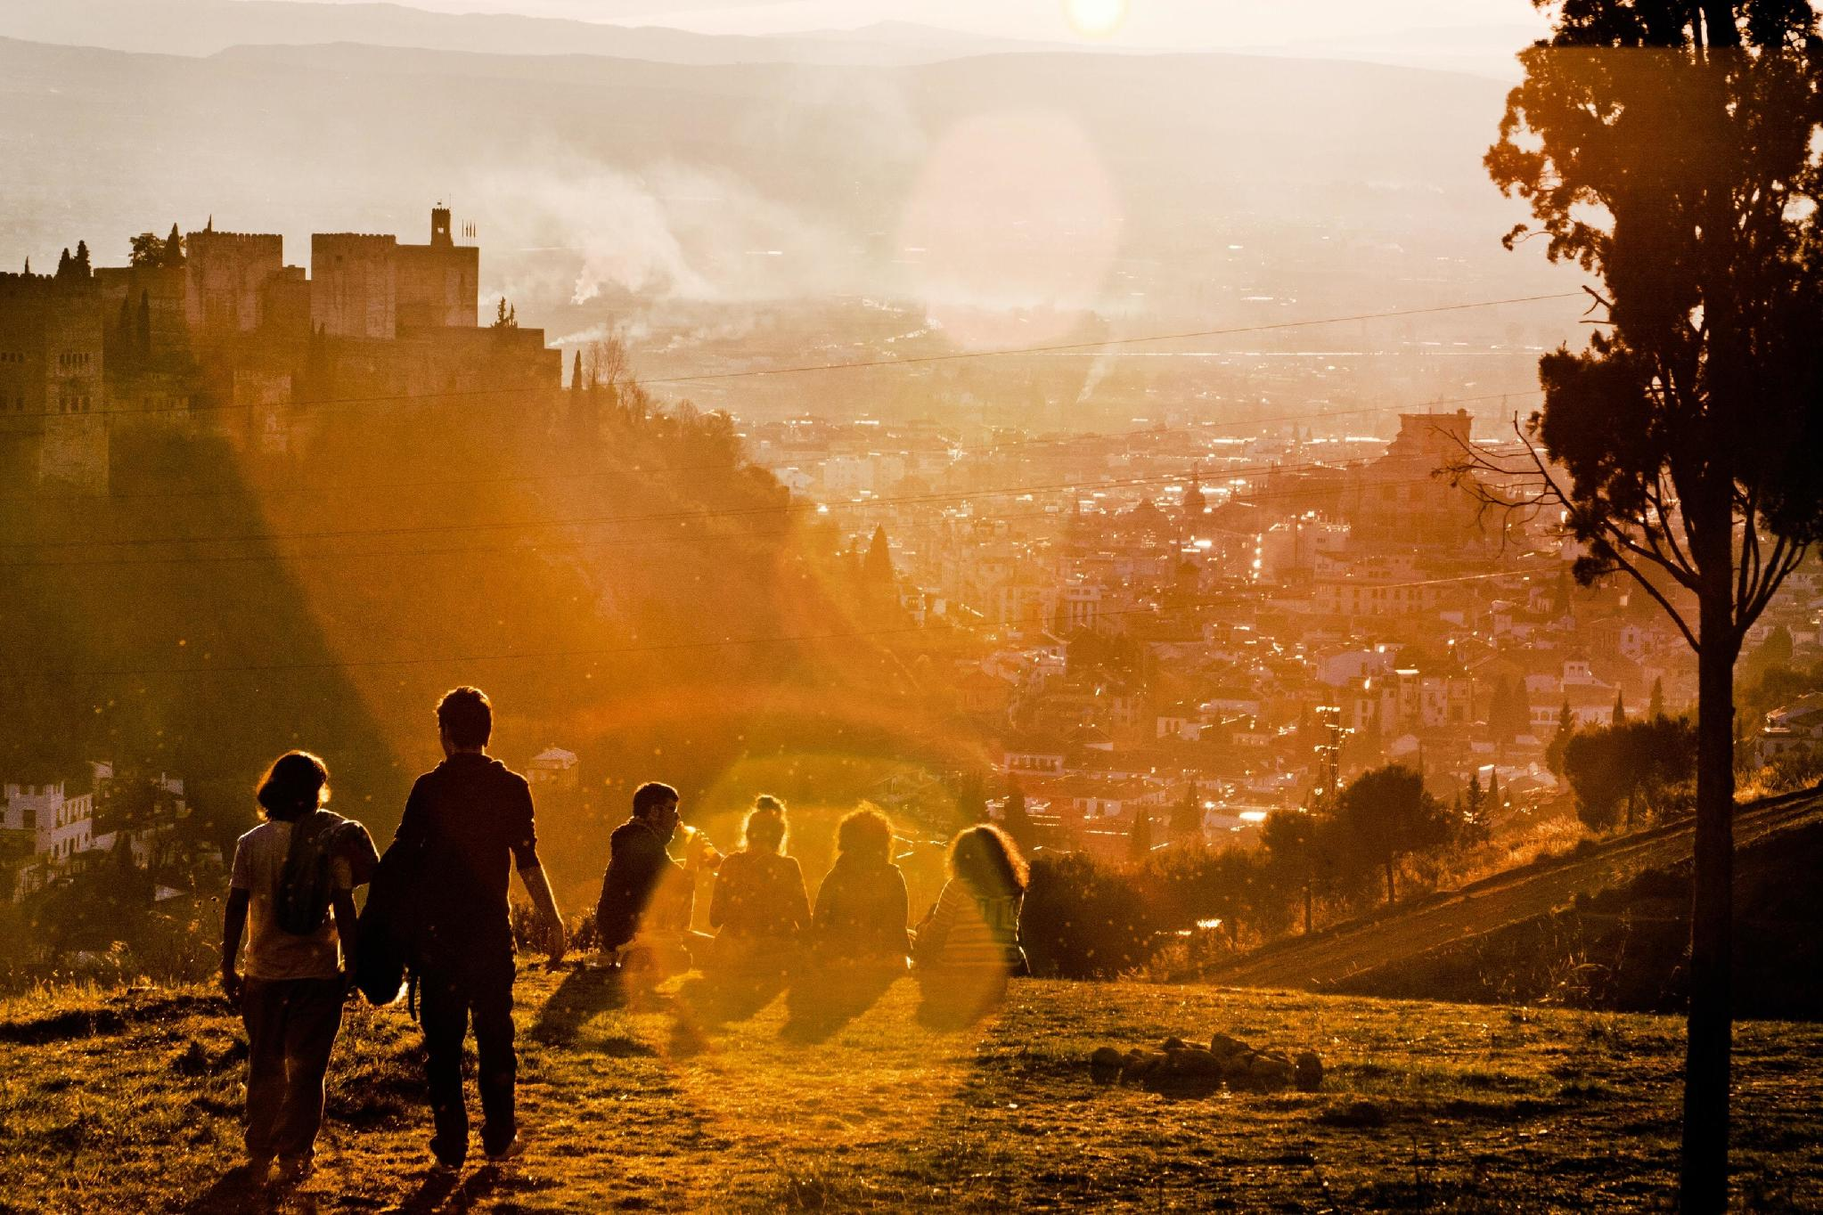



CO-ADAPT | Nature-Based Solutions Seminar
Why Nature-Based Solutions?
Cities are facing overlapping pressures that cannot be solved by concrete alone.
Heat waves
Heavy rain
More shade, cooling and evapotranspiration
Absorb, store and slowly release water
Biodiversity loss
Social stress
Create habitats and ecological corridors
Make shared places healthier and more welcoming
Notes:
Cities today face multiple challenges at the same time.
We experience hotter summers, more frequent heatwaves, heavier rainfall events, biodiversity decline, and increasing social stress.
For decades, cities have often responded with more concrete, more engineering, and larger technical infrastructure.
These solutions are important, but they are often expensive and sometimes address only one problem at a time.
Nature-based solutions are different.
They allow us to address several challenges simultaneously while improving quality of life.
A single tree can provide shade, cool the air, capture carbon, support biodiversity, and make a street more pleasant.
Nature becomes infrastructure.

Slide 5
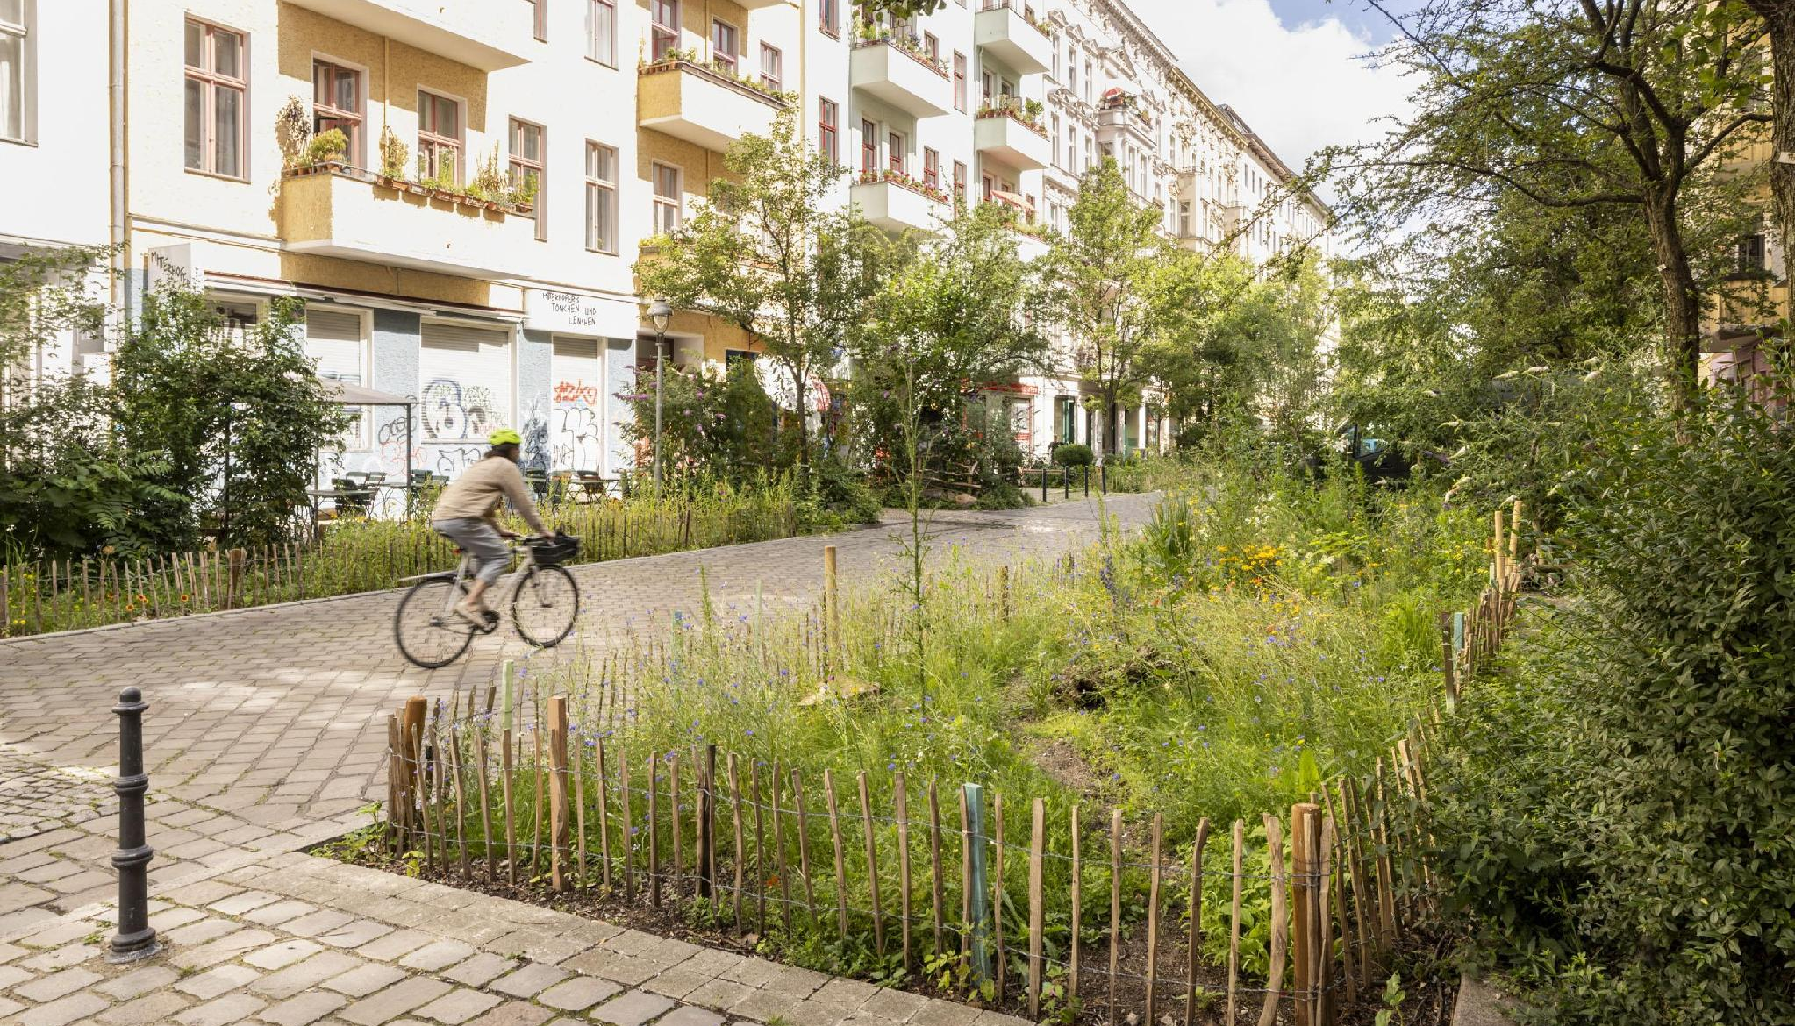
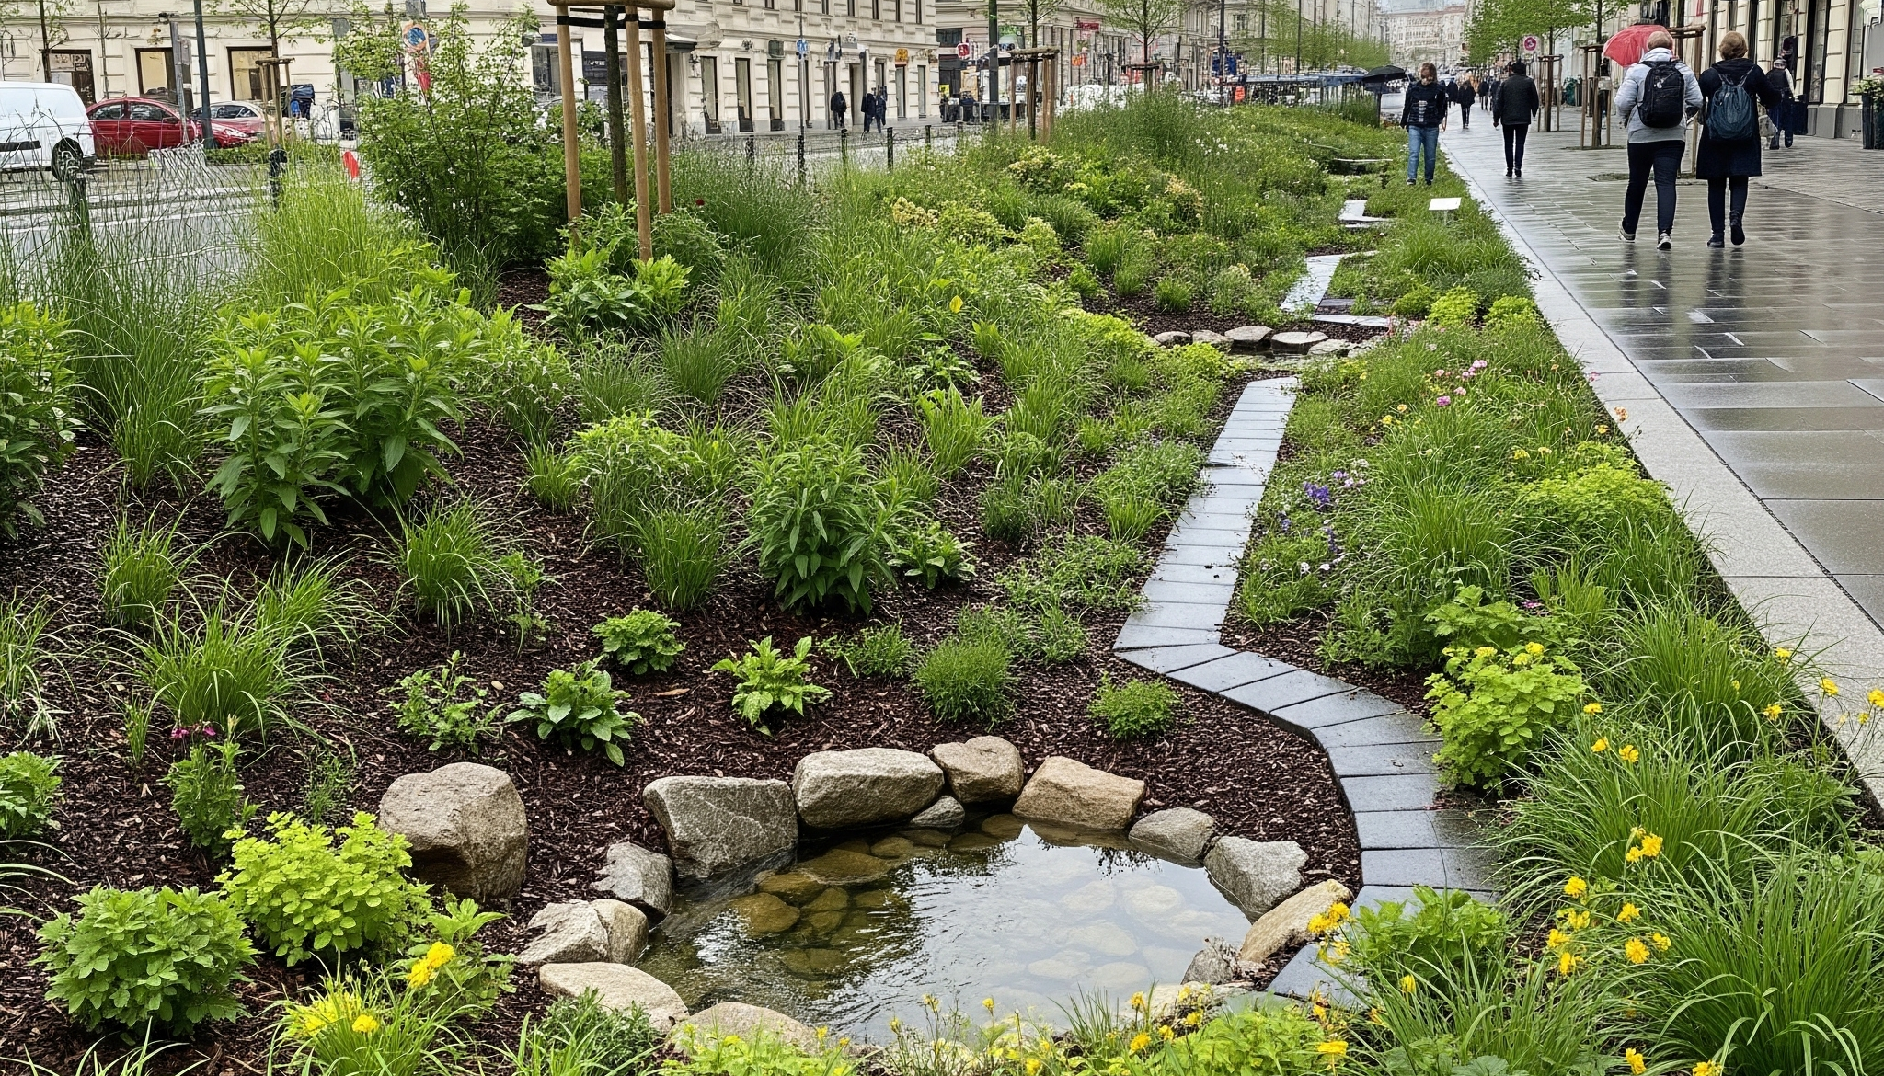
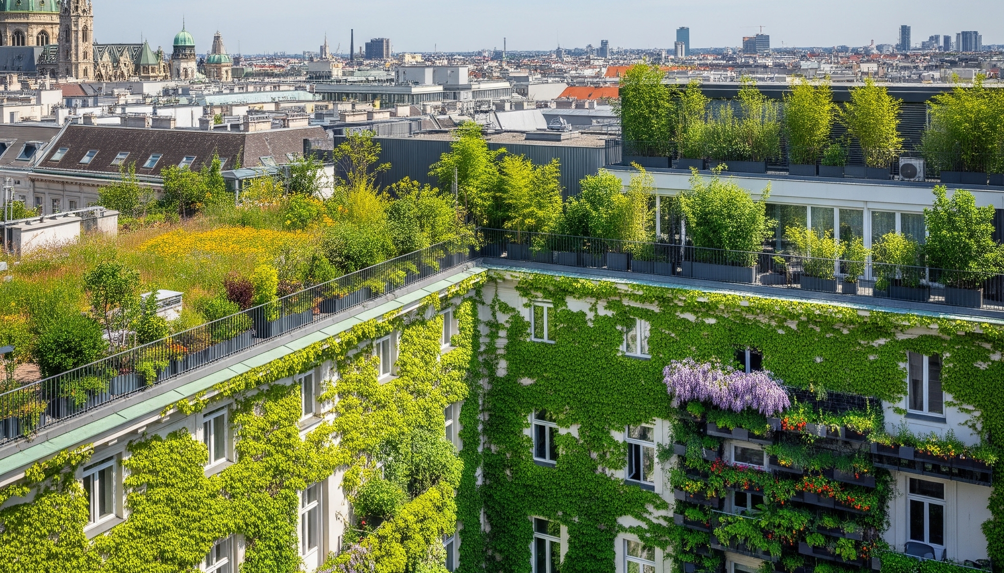
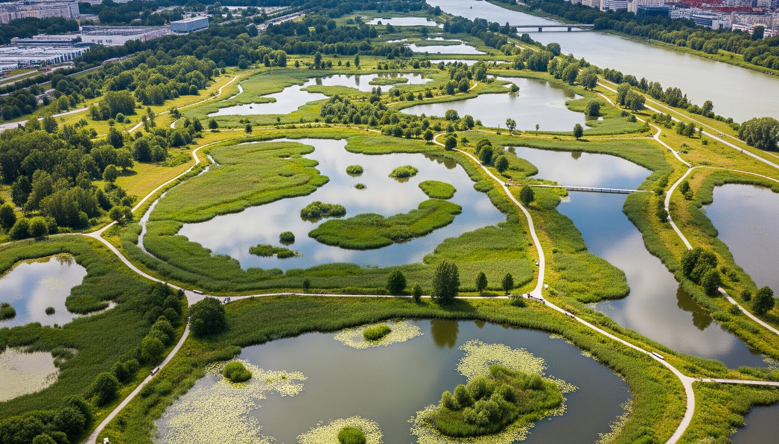
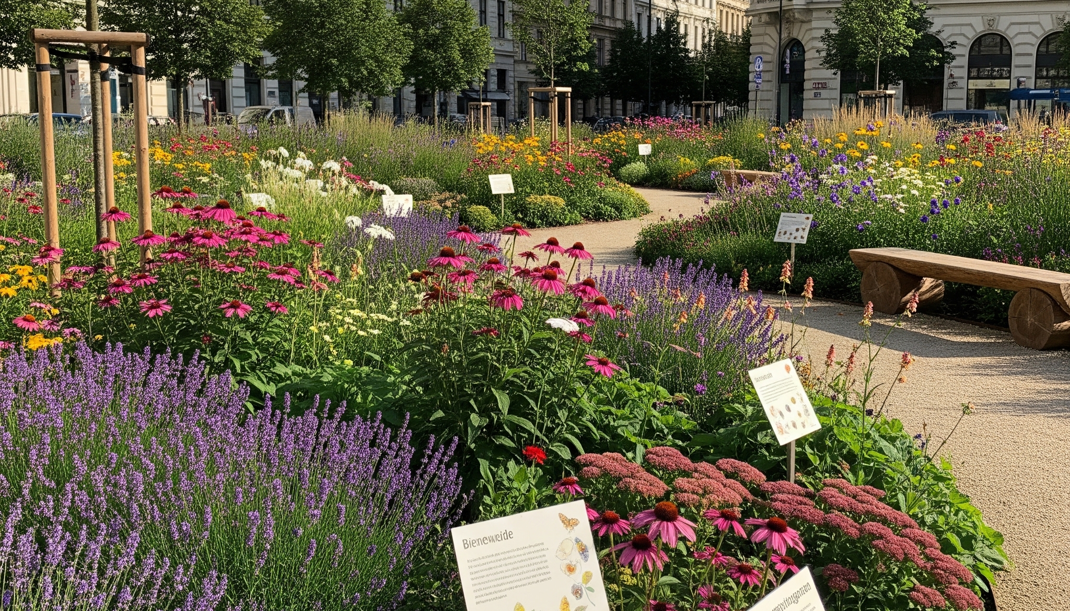
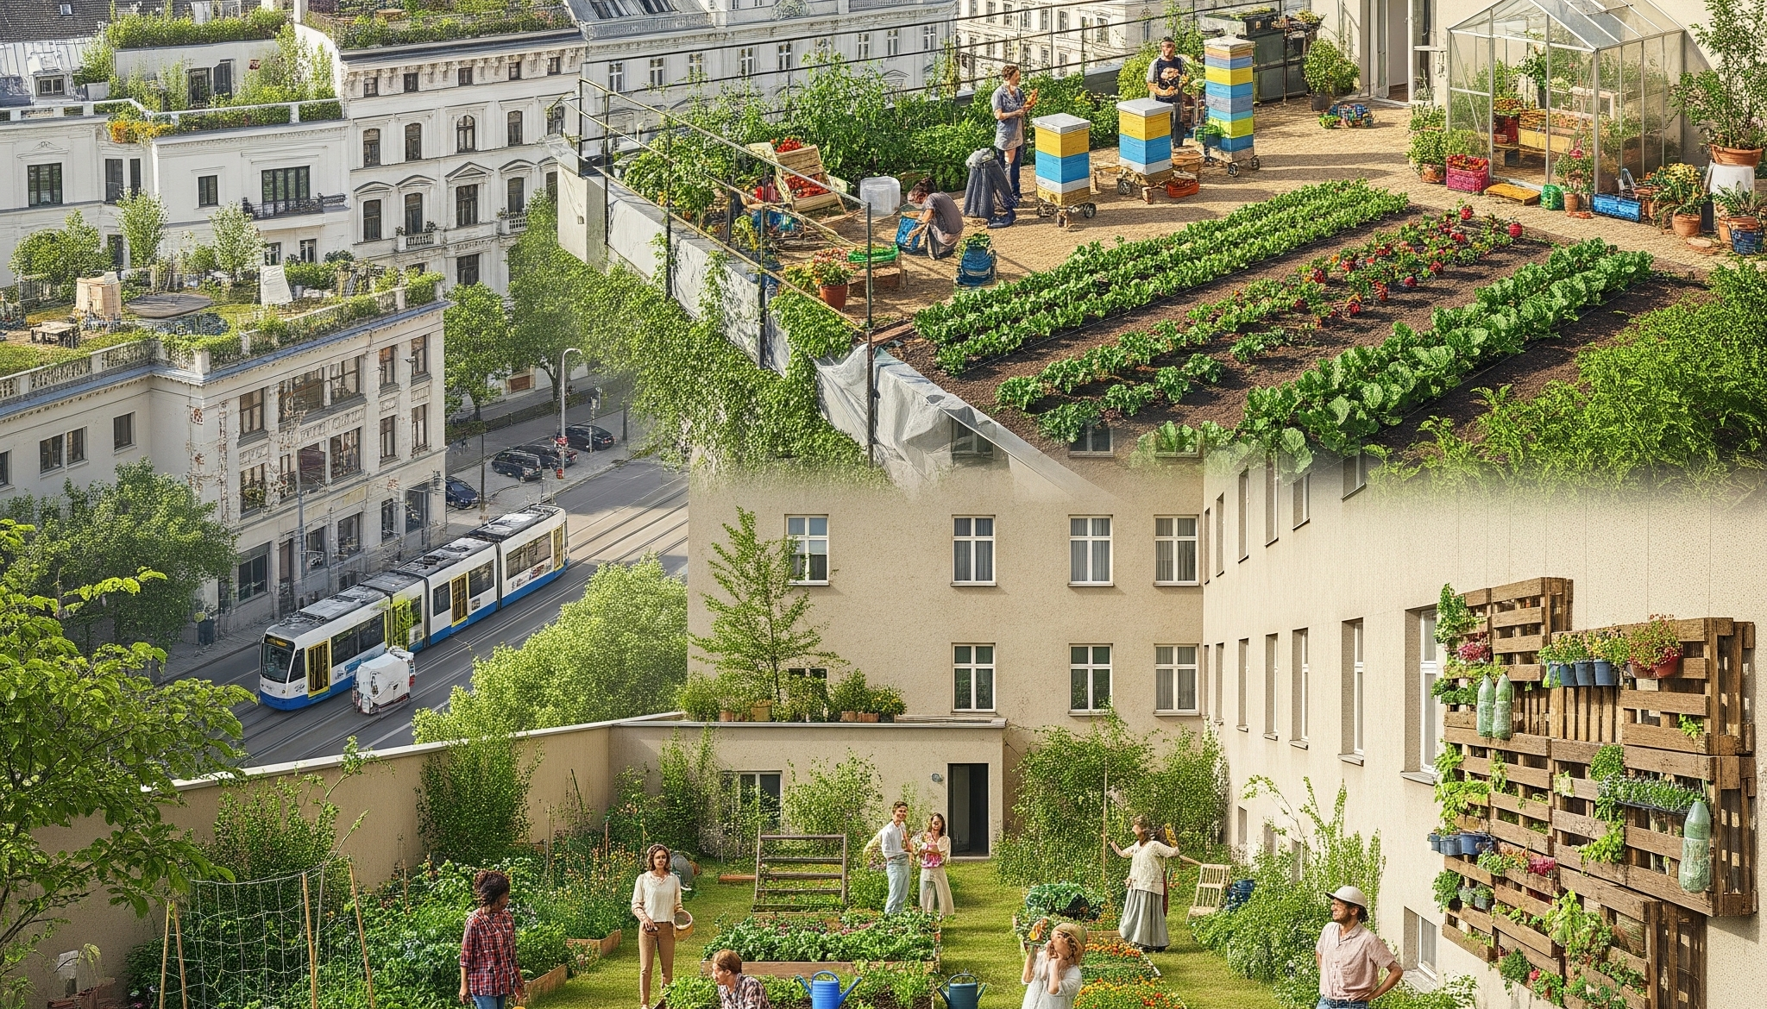
CO-ADAPT | Nature-Based Solutions Seminar
What Are Nature-based Solutions?
Nature-based Solutions use living systems to address societal challenges while benefiting people and biodiversity.
Urban trees and cool streets
Rain gardens and bioswales
Green roofs and facades
Wetlands and retention areas
Pocket parks
Community gardens
Notes:
Nature-based solutions are actions that work with nature rather than against it.
They use natural processes to address societal challenges while creating benefits for both people and biodiversity.
Some examples are very large.
Wetlands that protect entire regions from flooding.
Urban forests that cool city districts.
Others are surprisingly small.
A rain garden.
A green roof.
A community garden.
A planted tree pit.
The important thing is not the size of the intervention.
The important thing is that it delivers benefits for both people and nature.

Slide 6
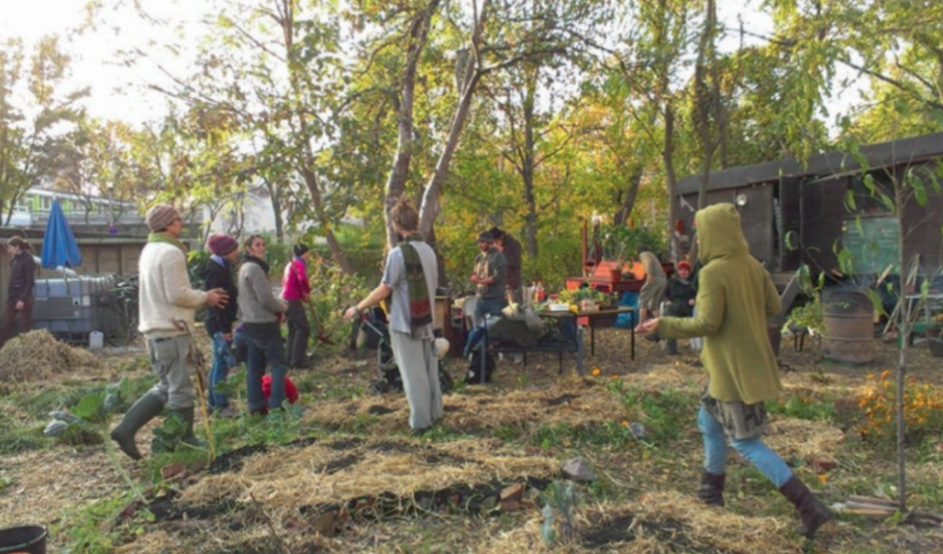
CO-ADAPT | Nature-Based Solutions Seminar
What is Co-ADAPT?
Co-ADAPT shifts nature-based solutions from research and policy spaces into the hands of urban communities.
Engages citizens in climate adaptation and biodiversity action
Connects neighbourhood observations with practical interventions
Supports walking tours, seminars, DIY kits and local co-creation
Builds bottom-up democratic processes around urban nature
Source: Uploaded Venna seminar brief and UfU Co-ADAPT presentation.
Notes:
This brings us to Co-ADAPT.
The idea behind Co-ADAPT is simple.
Nature-based solutions should not remain only in policy documents, scientific reports, or expert discussions.
They should become visible and accessible to ordinary citizens.
Through walking tours, seminars, DIY activities, and community engagement, Co-ADAPT helps people discover opportunities for nature-based solutions in their own neighbourhoods.
Instead of asking what governments should do, we also ask:
What can communities do together?

Slide 7
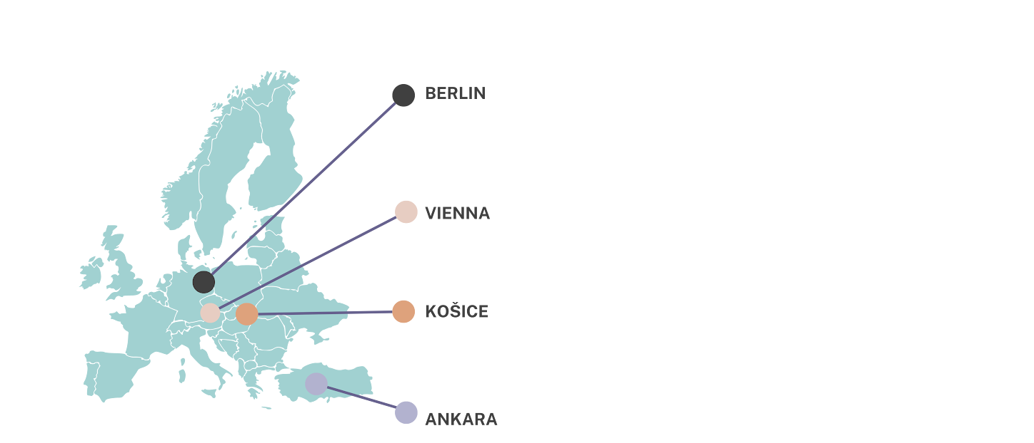
CO-ADAPT | Nature-Based Solutions Seminar
Co-ADAPT Cities and Partners
A learning network across different urban contexts.
Berlin
Vienna
Ankara
Košice
Germany
Austria
Türkiye
Slovakia
UfU
IEC
DKM
People & Water
To make climate adaptation visible, local and achievable through community-led nature-based solutions.
Notes:
The project connects four cities:
Berlin,
Vienna,
Ankara,
and Košice.
Each city faces different climate challenges and social contexts.
Yet all four cities share a common goal:
Making climate adaptation more local, visible, and participatory.
By learning from each other, we can discover solutions that work across Europe.

Slide 8
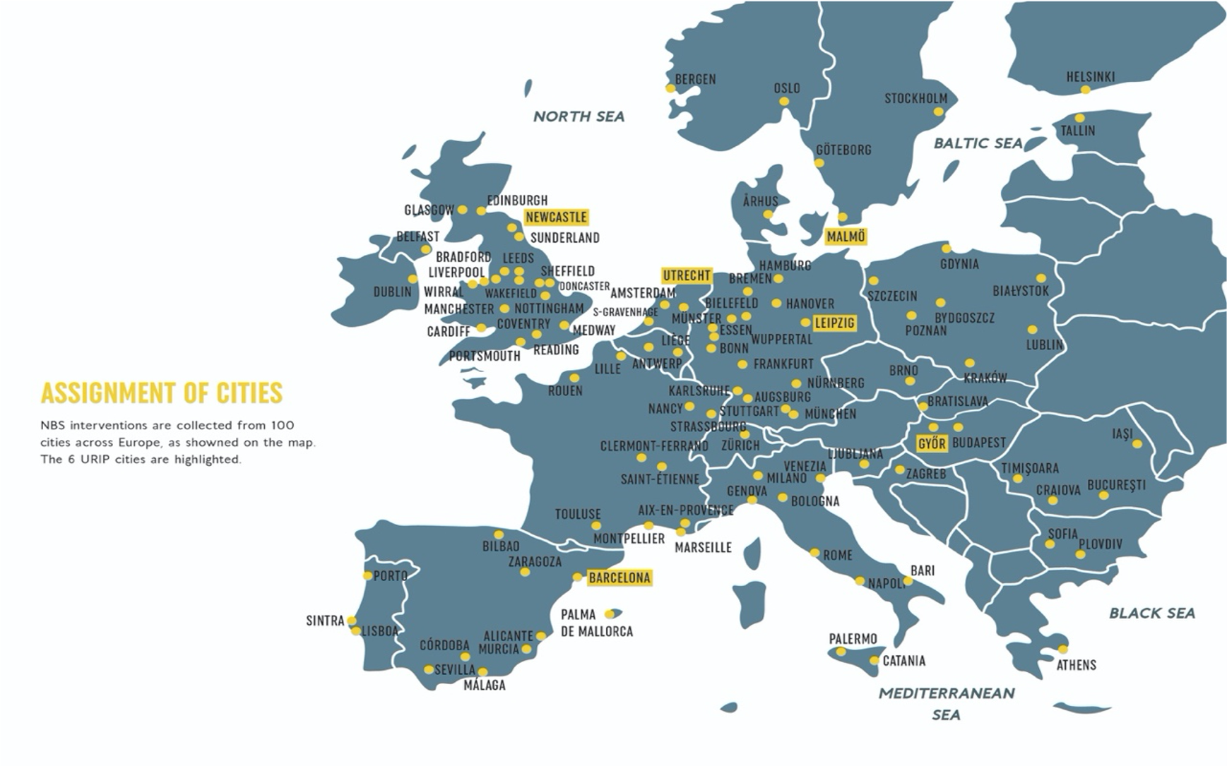
CO-ADAPT | Nature-Based Solutions Seminar
Europe: Urban NbS Are Already Scaling
Across Europe, cities are using green-blue infrastructure to respond to heat, flooding and biodiversity decline.
Urban Nature Atlas
Nearly 1,000 examples from 100 European cities documented through NATURVATION.
Notes:
Before we look at individual projects, I would like to zoom out and look at the bigger picture.
Sometimes, when we see a rain garden, a green roof, or a community garden, we think of it as an isolated project.
But across Europe, something much larger is happening.
Researchers working through the NATURVATION project documented nearly one thousand examples of nature-based solutions in more than one hundred European cities.
This tells us something important:
Nature-based solutions are no longer experimental ideas.
They are becoming part of mainstream urban planning.
Cities are investing in nature not only because it is environmentally beneficial, but because it delivers multiple benefits at the same time.

Slide 9
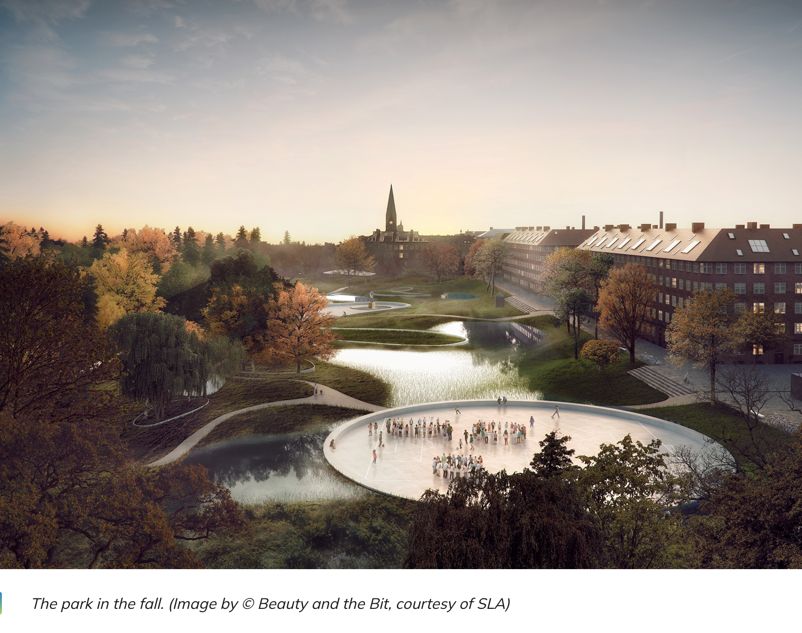
CO-ADAPT | Nature-Based Solutions Seminar
Copenhagen: Floodable Parks
The city uses floodable parks, green spaces, and canals to temporarily store and slow down stormwater during heavy rainfall.
Reduces urban flooding
Protects homes and infrastructure
Creates attractive public spaces
Enhances biodiversity
Improves urban climate resilience
"Parks for people every day, reservoirs for water when needed."
Notes:
Copenhagen has become a global leader in climate adaptation.
After experiencing severe flooding events, the city adopted a different way of thinking about rainwater.
Instead of treating water as a problem to remove as quickly as possible, Copenhagen began creating places where water could safely stay.
Floodable parks are one example.
Most of the time they function as parks for recreation and relaxation.
During heavy storms they become temporary water reservoirs.
The same space serves multiple purposes.
This is a perfect example of nature-based thinking.

Slide 10
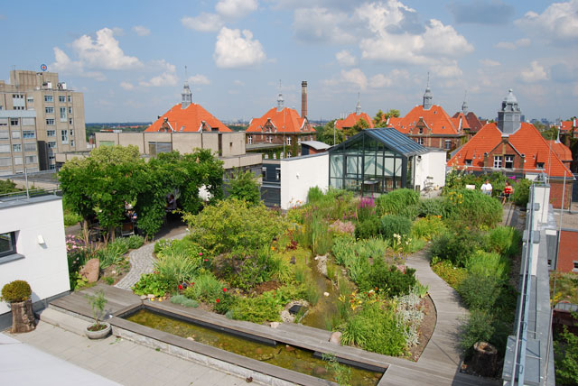
CO-ADAPT | Nature-Based Solutions Seminar
Berlin: Green Roofs and Facades
GründachPLUS supports green roofs and green facades as climate adaptation infrastructure.
Retain rainwater
Improve insulation
Reduce local heat
Create habitat for insects and birds
Combine with solar energy where possible
Turning rooftops into living infrastructure for a cooler, greener, and more resilient city.
Notes:
Berlin's GründachPLUS programme focuses on rooftops.
When we look at a city from above, we often see enormous unused surfaces.
Berlin asked:
What if roofs could become part of the climate solution?
Green roofs retain rainwater, reduce heat, provide habitat, improve insulation, and contribute to biodiversity.
Suddenly, a roof is no longer just a roof.
It becomes living infrastructure.

Slide 11
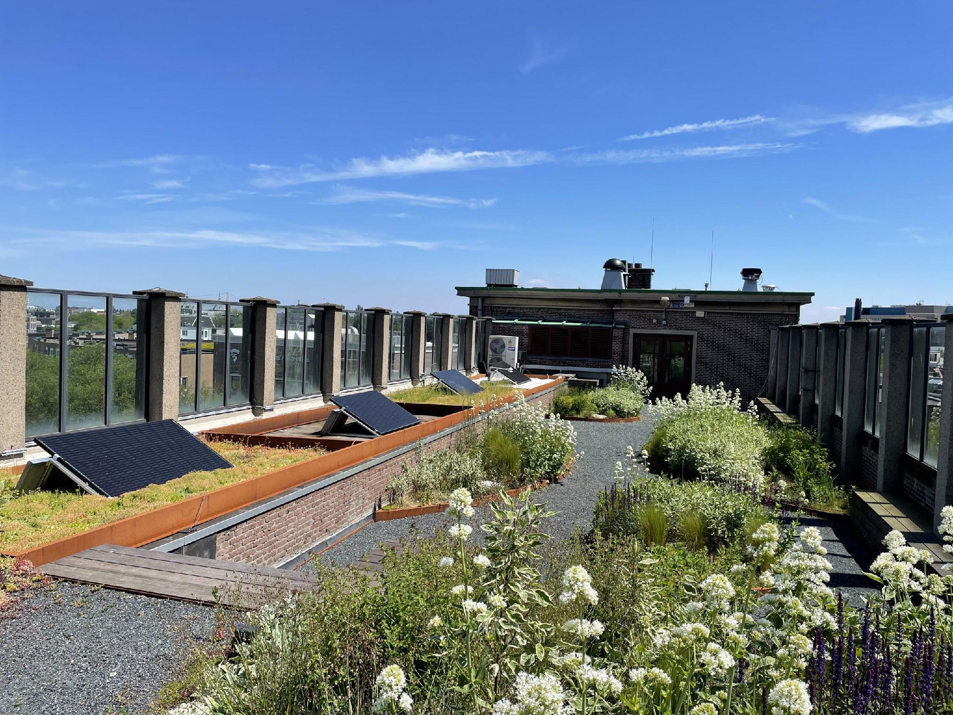
CO-ADAPT | Nature-Based Solutions Seminar
Amsterdam: RESILIO Smart Blue-Green Roofs
Roofs act as a network of decentralized water buffers, helping the city function like a sponge during heavy rainfall and dry periods.
Reduces urban flooding
Cools buildings and surrounding areas
Supports biodiversity
Improves climate resilience
Uses weather forecasts to optimize water storage
Every roof can become part of a city’s climate adaptation system.
Notes:
Amsterdam takes this concept even further.
The RESILIO project transforms roofs into smart water management systems.
These roofs can store rainwater when storms are expected and release water when conditions become dry.
Using weather forecasts and digital technologies, buildings actively participate in climate adaptation.
This project reminds us that innovation can happen when nature and technology work together.

Slide 12
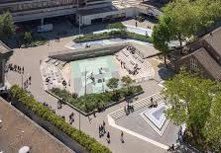
CO-ADAPT | Nature-Based Solutions Seminar
Rotterdam : Waterplein Benthemplein
It is designed as an innovative climate-adaptive solution that seamlessly combines dual functions: dynamic public recreational space during dry weather and a massive emergency stormwater reservoir during heavy rainfall.
Flood prevention
Urban cooling
Public recreation
Climate awareness
Multifunctional use of space
A square that becomes a reservoir when the city needs it.
Notes:
Rotterdam offers one of the most creative examples in Europe.
Benthemplein Water Square looks like an ordinary public square.
People play sports, meet friends, and spend time there.
But during heavy rainfall, the square transforms into a temporary water reservoir.
The same place becomes both social infrastructure and climate infrastructure.
This demonstrates that adaptation can be functional, beautiful, and enjoyable at the same time.

Slide 13
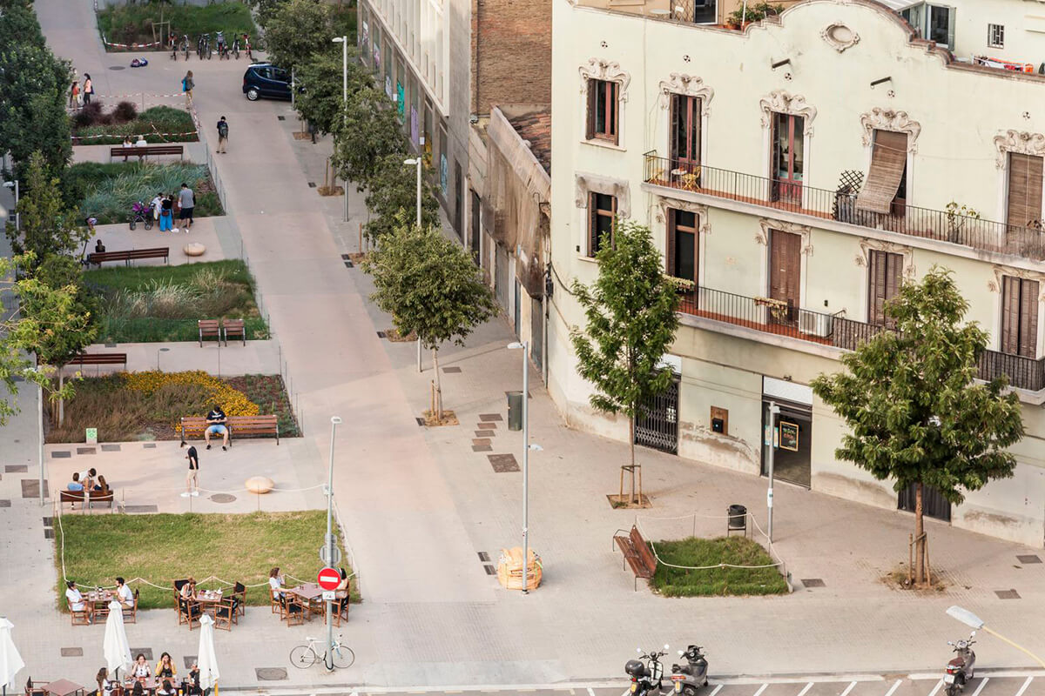
CO-ADAPT | Nature-Based Solutions Seminar
Barcelona : Superblocks
The city introduced Superblocks (Superilles), reorganizing several city blocks to prioritize people over cars.
Reduced air pollution
Lower urban temperatures
Increased biodiversity
More space for social interaction
Improved health and well-being
From stone and asphalt to shade and biodiversity.
Notes:
Barcelona's Superblocks address a different challenge.
Traffic, pollution, heat, and lack of public space.
The city reorganized streets to prioritize people rather than cars.
Trees, public spaces, biodiversity, and community life became more important than traffic flow.
Climate adaptation here is not only about environmental performance.
It is also about creating healthier and happier places to live.

Slide 14
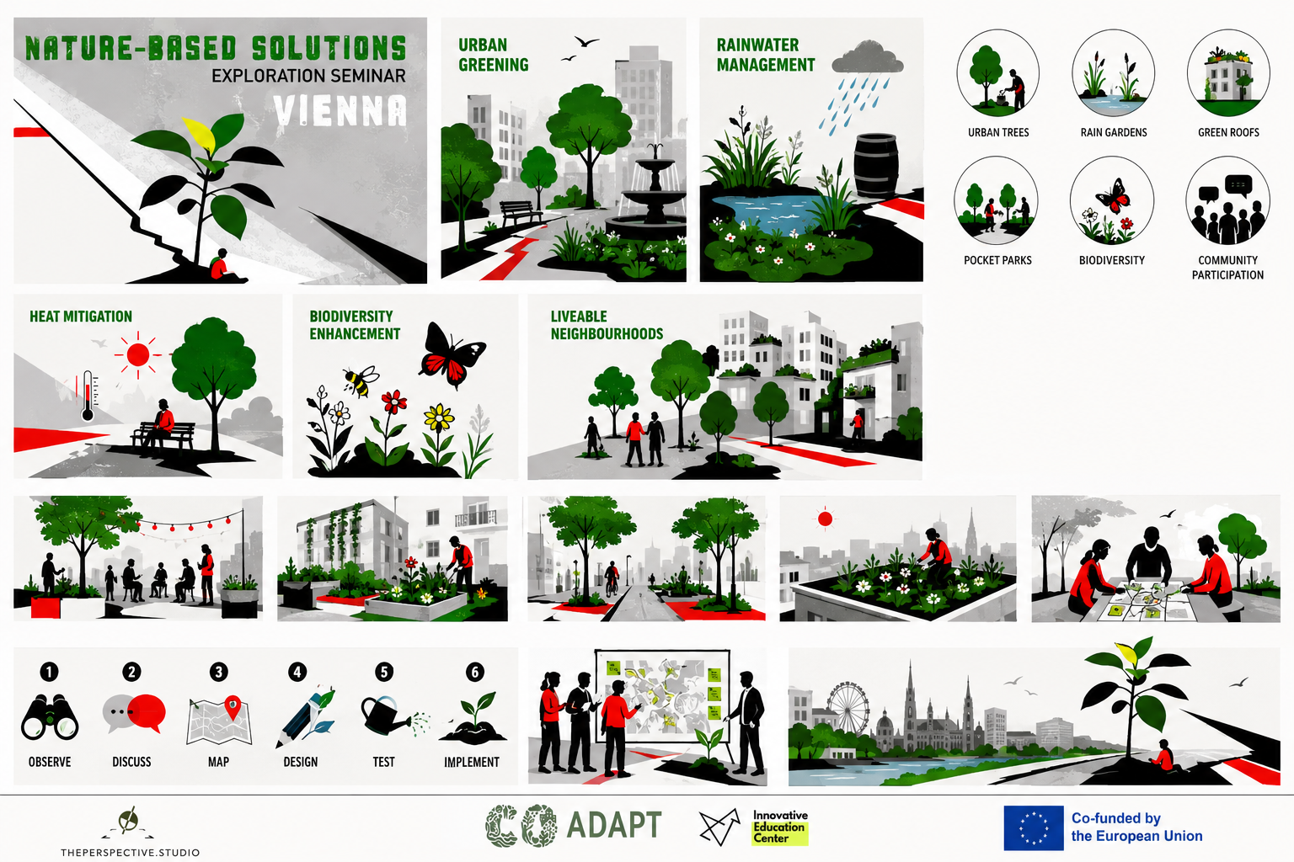
CO-ADAPT | Nature-Based Solutions Seminar
Austria and Vienna: Climate Adaptation Context
Vienna aims to become climate-neutral and climate-resilient by 2040, while heatwaves and sealed surfaces make everyday urban comfort a growing challenge.
Heat stress
Heavy rainfall
Dense districts
Public health
Shade, trees, water and reflective surfaces
Sponge-city design and local retention
Micro-greening, schoolyards, courtyards and streets
Heat action, cool places and accessible information
Where can small nature-based interventions create the most comfort, beauty and resilience?
Notes:
Now let's focus on Vienna.
Vienna is already one of Europe's most livable cities, but it also faces increasing climate challenges.
Heatwaves are becoming more frequent.
Heavy rainfall events are becoming more intense.
Dense urban districts often lack sufficient green space.
These challenges create opportunities for nature-based solutions.
The question is not whether adaptation is necessary.
The question is where and how we can implement it.

Slide 15
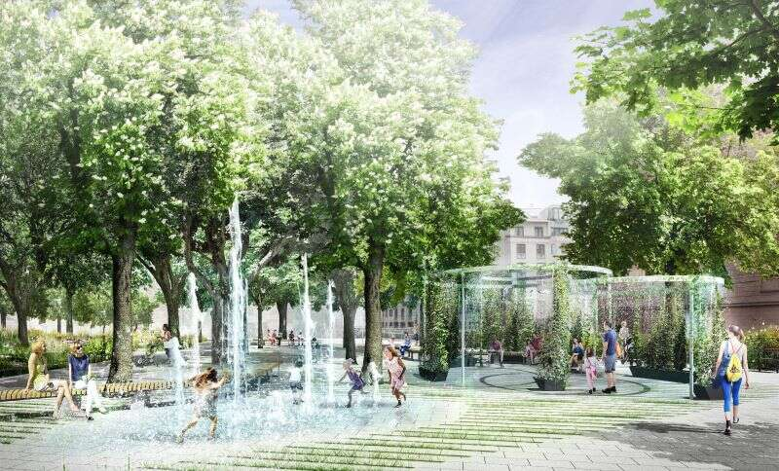
CO-ADAPT | Nature-Based Solutions Seminar
Vienna Example: Cool Streets
The “Cool Streets” approach temporarily or permanently transforms streets into shaded, social and cooling public spaces.
Trees and mobile greenery
Misting or water elements
Seating and traffic calming
Brighter surfaces that absorb less heat
A practical response to heat vulnerability
The construction of the capital’s first “Cooling Park”, a €1m ($1.2m) project covering the 10,600-square-metre Esterházypark, is designed to provide relief.
Sources: Eurisy Vienna Cool Streets case; Street Experiments Coole Straßen.
Notes:
One response is the Cool Streets initiative.
These projects transform streets into cooler and more welcoming public spaces.
Trees, seating areas, shading structures, and water elements help reduce heat stress and improve comfort.
The idea is simple.
If climate change affects everyday life in public spaces, adaptation should also happen in public spaces.

Slide 16
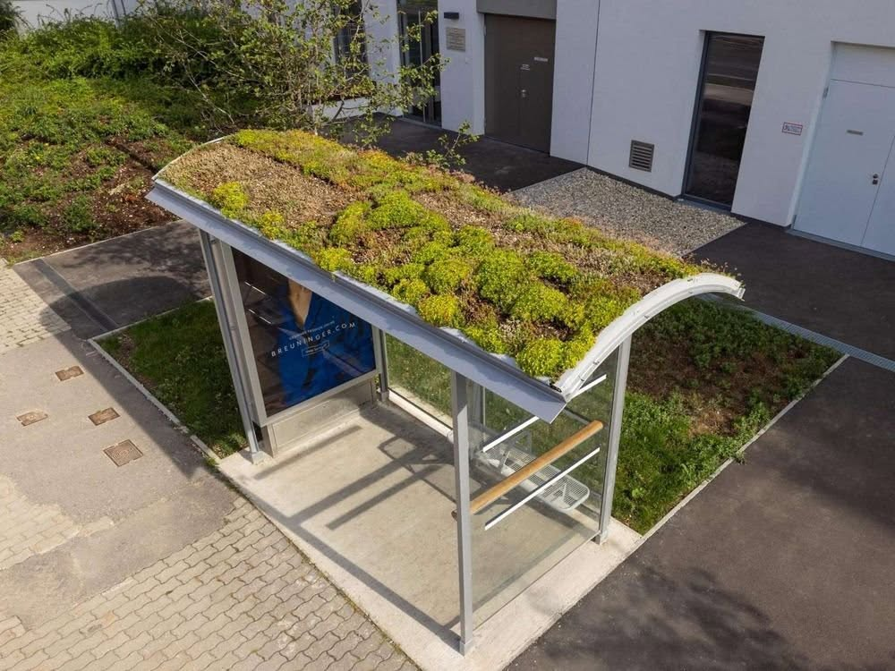
CO-ADAPT | Nature-Based Solutions Seminar
Vienna Example: Green Roofs and Bus Stops
Vienna has tested green roofs on public transport stops to reduce heat stress for passengers and add green infrastructure to everyday mobility.
Sedum mat roofs are easy to install and low maintenance
Green roofs help retain rainwater and support cooling
Bus stops can become visible micro-NbS in daily life
The vegetation lowers ambient temperatures by up to 1.5°C at the stop via shade and evapotranspiration, providing immediate relief from the urban heat island effect.
Notes:
Sometimes adaptation happens at a very small scale.
Vienna's green bus stops are a wonderful example.
A place where people wait for public transport becomes greener, cooler, and more pleasant.
This reminds us that meaningful change does not always require large investments.
Small interventions, repeated throughout a city, can have significant impacts.

Slide 17
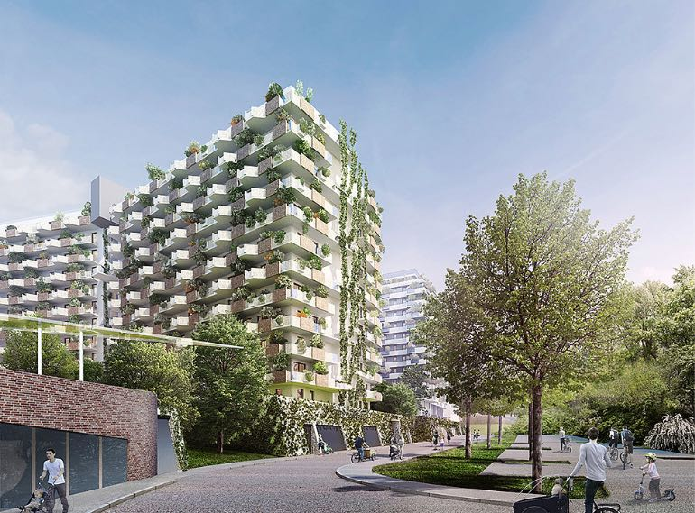
CO-ADAPT | Nature-Based Solutions Seminar
Vienna Example: Biotope City
Biotope City Vienna demonstrates how housing development can integrate a package of NbS.
Large-scale green roofs
Green facades
Artificial wetlands
Water ponds for rainwater retention
Shade-optimized trees and vegetation
Green roofs
Facades
roof habitat + water retention
cooling + biodiversity
Wetlands
Ponds
water purification
storage + microclimate
Notes:
Biotope City demonstrates what happens when nature-based solutions are integrated into urban development from the beginning.
Green roofs.
Green facades.
Wetlands.
Water retention systems.
Trees.
Biodiversity.
Everything works together as a connected system.
Rather than adding nature afterwards, nature becomes part of the design itself.

Slide 18
CO-ADAPT | Nature-Based Solutions Seminar
Community-Led Options for Vienna
For Co-ADAPT, the most useful examples are not only spectacular projects - they are repeatable actions that people can adapt locally.
Green balconies
Tree pit gardening
Rain barrels
small habitats and cooling at home
care for existing street trees
store water for dry periods
Parklets / Grätzloasen
Schoolyard greening
Micro-forests
turn asphalt into shared space
learning landscapes
dense shade and biodiversity
Notes:
Perhaps the most important lesson from today's examples is this:
Many nature-based solutions are accessible to communities.
A green balcony.
A tree pit garden.
A rain barrel.
A micro-forest.
A parklet.
These are not projects reserved for experts.
They are opportunities for citizens to become active participants in shaping their neighbourhoods.

Slide 19
CO-ADAPT | Nature-Based Solutions Seminar
Co-Creation Task
Translate today's inspirations into concrete ideas for your nature-rich neighbourhood.
Where?
Which street, corner, roof, courtyard, bus stop or empty edge has potential?
What?
Which NbS could fit the site: shade, water, habitat, seating or food?
Who?
Which neighbours, students, NGOs, businesses or authorities need to be involved?
How?
What is the smallest first step that makes the idea testable?
Think of one place you know. What could nature do there - if citizens, designers and authorities worked together?
Notes:
Now we move from inspiration to action.
I would like each of you to think about a specific place.
A street.
A courtyard.
A bus stop.
A schoolyard.
An empty corner.
Ask yourself:
What challenge exists there?
What nature-based solution could help?
Who would need to be involved?
And what would be the smallest first step?

Slide 20







CO-ADAPT | Nature-Based Solutions Seminar
What Makes an Effective Nature-based Solution?
Before designing your idea, consider these seven guiding principles.
Ecological Impact
Supports biodiversity and natural processes
Climate Adaptation
Reduces heat, manages water, builds resilience
Social Benefits
Inclusive, safe and useful for people
Feasibility
Realistic, affordable and maintainable
Multiple Benefits
Addresses several challenges at once
Connectivity
Connects green spaces and ecological networks
Stewardship & Participation
Encourages ownership and collective care
The most effective Nature-based Solutions work simultaneously for people, nature, and climate.
Notes:
Before you begin designing your intervention, I would like to introduce seven principles that can guide your thinking.
These are not strict rules, nor are they a checklist that you need to satisfy perfectly. Instead, think of them as a set of lenses through which you can look at your idea. They are questions that can help you develop stronger, more creative, and ultimately more effective nature-based solutions.
Very often, when we think about improving a place, we focus on only one issue. For example, we may think about planting trees simply to create shade, or adding vegetation only to make an area look more attractive. But nature-based solutions invite us to think more systemically.
A good nature-based solution usually addresses several challenges at the same time. It benefits people, supports biodiversity, and helps communities adapt to climate change. It creates value not only today, but also in the long term.
As you work in your groups, I encourage you to keep these seven principles in mind.
Ask yourselves:
Does our idea support biodiversity and natural processes?
Will it help people feel more comfortable, connected, or welcome in this space?
Can it reduce heat, manage rainwater, or make the area more resilient to climate impacts?
Is it realistic? Could local communities actually implement and maintain it?
Does it create multiple benefits instead of solving just one problem?
Does it connect with other green spaces and strengthen ecological networks?
And finally, will people feel ownership of this place? Will they care for it and continue to use it over time?
Remember, there is no single correct answer. Different groups may develop very different ideas for the same place, and that diversity of perspectives is one of the strengths of co-creation.
At the end of the exercise, you will return to these same seven principles and use them to evaluate your ideas. This will help you reflect not only on what you designed, but also on why your solution might succeed, where it could be improved, and how it could create even greater benefits for both people and nature.
So, as you begin, try to think beyond individual elements and imagine the whole system. Ask yourselves not only, "What can we add to this place?" but also, "What relationships between people, nature, and climate can we strengthen here?"

Slide 21
CO-ADAPT | Nature-Based Solutions Seminar
Cities become resilient when nature and people grow together
Thank you
zentrumib.org
Notes:
As we conclude, I would like to leave you with one final thought.
Nature-based solutions do not begin with technology.
They do not begin with funding.
They do not begin with policy.
They begin with observation.
With imagination.
And with people who care enough about a place to improve it.
Cities become resilient when nature and people grow together.
Thank you very much.
I look forward to hearing your ideas.

